Slide 1
SOFTWARE REQUIREMENTS SPECIFICATION
Karpagam Institute Of Technology
For
Grocery Delivery Website
Prepared by:-
Rithik Kumar Ragavan M
Balamurugan A
Dhinesh S BharathiMohan K
Academic Year: 2023-2024

Slide 2
1.Introduction
  Purpose
The project enables customers to order groceries online from their preferred store. The grocery industry is a huge industry by any parameters and it is growing by leaps and bounds regardless of the challenges it is fraught with. We all need food for survival so we all go to a grocery to quench this basic human need. A growing trend of online grocery shopping has been seen. A number of reasons can be attributed to this. From high-pressure jobs to the convenience of Grocery Delivery Application, to distances, long queues at the mall, maintaining work-life balance, etc you can have any innumerable reasons why people prefer online grocery shopping to buy grocery from brick and mortar stores.
In fact, if you look at parents today, they juggle with so many responsibilities than what the parents of older generations had to do. Paying EMIs, long working hours all of these are propelling parents towards ease of online shopping in order to purchase food for their children. As a matter of fact, parents are the biggest demographic which is leading towards the Grocery Delivery Application trend.
  Product Scope
As a grocery delivery project, it has a lot of scope in the commercial field. Since everything is now available at everybody's doorstep so a project like this is very much viable in the future.
The grocery mobility solutions such as Instacart, Grofers and Bigbasket have already made a huge impact on the on-demand grocery market, hence there is no confusion in saying that future of the grocery delivery mobile websites will continue to bloom in the coming years.
  Intended Audience and Document Overview
Keeping in mind the age of all the users, the UI design is very simple and usable by customers belonging to all age groups.
This document highlights the pros and cons of the projects and all the essential requirements for the development of the project.
  References
    https://www.coursehero.com/file/107277576/Online-Grocery-Management-System- SRS-Documentdocx/
    https://studylib.net/doc/25786357/srs-online-shopping
    https://www.bigbasket.com/

Slide 3
2.Overall Description
2.1 Product Overview
2.1.1 Convenience
One of the biggest reasons to use a grocery shopping website is the convenience that it provides to its users.
The users now don't need to go and wait in a queue of the grocery store. They can just order anything from their smartphone or computer and it will be delivered to their doorsteps in a short period.
    Time saver
If you've a day job then going to grocery becomes a frustrating task. It's because it could waste your entire evening as it requires you to travel to the grocery store, check things out, pick it up, and then travel back to home.
However, with a grocery delivery website, you can do your grocery shopping by just sitting at your home.
In just few minutes you can order your grocery on the phone or computer and get it delivered on your doorsteps.
    Money saver
Apart from saving time and energy, online grocery shopping websites also saves your money.
They do it because of the two reasons. First, they save all your travel expenses and secondly it offers you with various discounts, loyalty points, and many more.
    Shop for others easily
Another major advantage of grocery delivery website solution is that it allows you to shop not only for you but also for your loved ones. Now you can help your sick and old aunt who faces a lot of trouble shopping for groceries at the grocery store which is located far apart.
All you must do is enter her address and select all the groceries that you want to deliver at her place. And in a short time, all the groceries will be delivered at her doorstep.
    Avoid impulsive buying
Grocery shopping delivery website is a boon for all the shopaholics. Many a times, we end up buying that extra carton of snacks or chocolates which wasn't on our list. The grocery store is generally filled with tempting products that we find hard to resist.
However, with an website for grocery delivery, shopaholics can curb their instincts for their own good. They can buy only those items which were on the list and don't end up piling things which they never intended to buy in the first place.

Slide 4
  Product Functionality
    To identify person ordering grocery and contact him in case of an issue
      Sign up
      Sign in
      User Profile
      Forget Password
      Edit Profile
      Verify email and phone number
    Learn the customer's demand and how he would like to pay for it.
      Order Menu
      Product Search
      Search Filters
      Search Suggestions
      Quantity counter
      Shopping Cart
      Checkout
      Discount Coupon
      Payment Gateway
    The location where customer wants the demanded person or thing
      Customer's Location
      Address Search
      Switch delivery location
      Set Favourites
      Pin Address on map
    How much time does the customer expects the delivery
      Pick Time Slot
      Express Delivery
      Track delivery person
      Contact delivery person
      Cancel Order
    Are people happy with the services, supplier or quality? If so, how much?
      Rate Services
      Rate Delivery Boy
      Rate Product Quality
      Write a review
      Support and Help

Slide 5
What are technologies involved?
  Dependencies
    APIs
    Server Connections
    Database
Specific Requirements
  External Requirements
    User Interfaces Requirements
      HTML
      JavaScript CSS
      React Framework
  Functional Requirements
    Ease of registration and login for the user
    Delivery in the quickest possible time
    Booking from nearby and Trustworthy stores based on location
    Ease of Payment through various gateways
    Usable on all smart devices

Slide 6
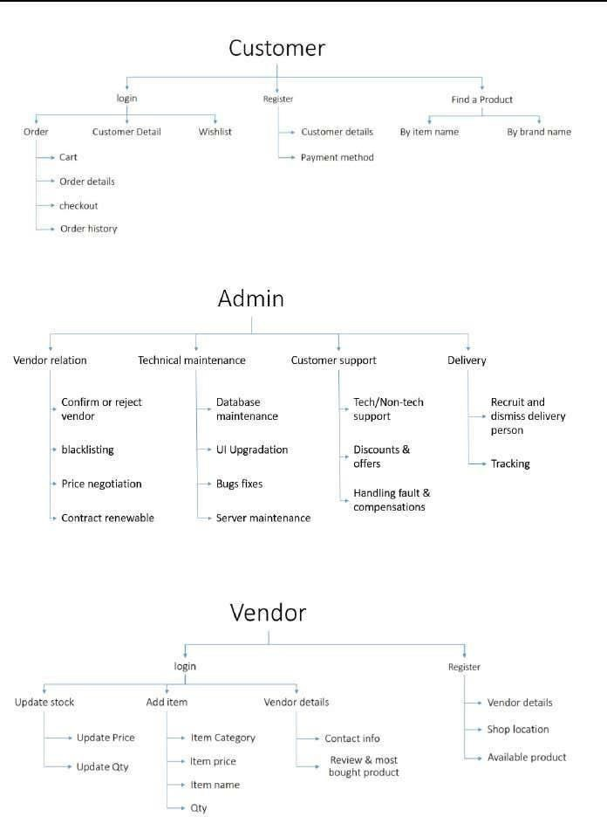

Slide 7
GITHUB LINK :
https://github.com/dhineshsar/NM_CD_13_Task1-PPT https://github.com/Balaannakili/NM_CD1_13_Task1_ppt https://github.com/Bharathicr7/NM_CD1_13_Task1-PPT\ https://github.com/Ragavrk/NM_CD1_13_Task1-PPT-

